Slide 1
Ionising radiation and nuclear reactions

Slide 2
The Nuclear Atom & Radiation Types

Slide 3
Learning Intentions
Differentiate between ionising and non-ionising radiation.
Understand the concept of background radiation.
Outline Rutherford's model of the atom.
Describe the experiments carried out by Rutherford to study atomic structure.
Understand the development of the Rutherford-Bohr atomic model.
Describe the arrangement of electrons in terms of orbitals.
Define atomic number, mass number and atomic mass.
Calculate the number of protons, neutrons and electrons in an atom from atomic number and mass.
Recall the different types of nuclide families.
Explain how an excess of protons, neutrons or mass in a nucleus can result in alpha, beta positive and beta negative decay.

Slide 4
Learning Intentions Continued
Symbolise alpha and beta particles.
Explain natural radioactive decay in terms of stability.
Define alpha radiation, beta positive radiation, beta negative radiation and gamma radiation.
Describe alpha, beta positive, beta negative and gamma radiation, including the properties of penetrating ability, charge, mass and ionisation ability.
Define half-life.
Solve radioactive decay problems involving whole numbers of half-lives.
Explain how an excess of protons, neutrons or mass in a nucleus can result in alpha, beta positive and beta negative decay.
Symbolise alpha and beta particles.

Slide 5
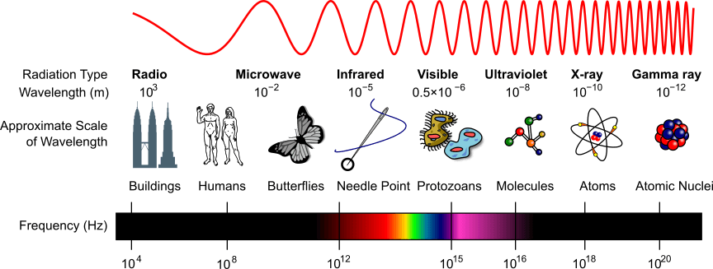
What is radiation?
Radiation is defined as the emission of energy as electromagnetic waves or as moving subatomic particles, especially high-energy particles, which cause ionisation.

Slide 6

Ionising or Non-ionising

Slide 7
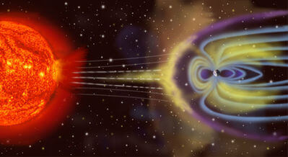
Ionising radiation
Ionising radiation is high energy.
Some examples include:
Gamma rays
X-rays
Ultraviolet Light
Cosmic rays
Alpha and Beta particles

Slide 8
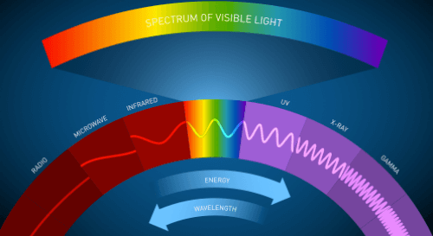
Non-ionising radiation
Non-ionising radiation is low energy.
Some examples include:
Visible light
Infrared radiation
Microwave radiation
Radiowaves
Non-ionising radiation can still affect our bodies, even though they don't ionise atoms.

Slide 9
Background Radiation
Background radiation is all around us.
It can be either cosmic or terrestrial.

Slide 10

Cosmic Radiation
Cosmic radiation comes from space. When protons interact with the Earth's atmosphere they cause cosmic showers of radiation. This can cause auroras!

Slide 11

Terrestrial Radiation
Terrestrial radiation comes from the radioactive decay of elements in the Earth's crust.
Radioactive decay contributes to the temperature of the Earth. There are radioactive elements such as Uranium and Thorium in the Earth's mantle and crust. As these decay, they release large amounts of heat energy.
Radioactive chemicals in the soil can enter the food chain. The radioactive minerals may be absorbed by plants, which are then eaten by animals, passing along the radioactive materials.

Slide 12
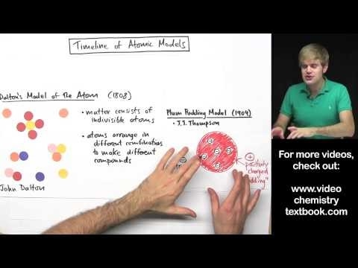
Atomic Structure
In 1909, New Zealand scientist Ernest Rutherford carried out an experiment to find the structure of the atom.
Before this experiment, the 'Plum Pudding' model was used to explain the structure of the atom.

Slide 13
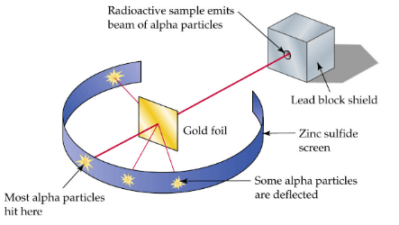
Rutherford’s experiments
Ernest Rutherford tested the plum pudding model by firing a thin beam of alpha radiation at a sheet of gold. This gold was very thin (0.6µm), so it was only a few hundred atoms thick.
This radiation was generated by radioactive material which was inside a lead box. This lead container had a small hole in it, which focussed the alpha radiation.
The gold sheet was surrounded by a sheet of zinc sulfide. This sparked whenever an alpha particle hit it, allowing Rutherford to see where the particles had been deflected to.

Slide 14
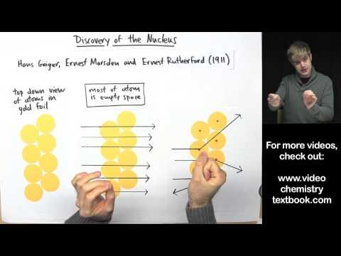
Rutherford’s expectations
Rutherford expected to see slight deflections of the alpha particles as they passed through the gold.
This is because Thomson's model said that there were some negative particles within the atom, which would slightly attract the positive alpha particles.

Slide 15
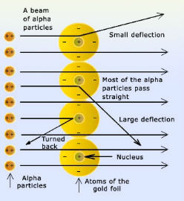
Rutherford’s results
To summarise Rutherford's results:
• | Most of the particles went straight through the gold foil and were not deflected. This was expected based on Thomson's model.
• | Some of the particles were deflected at small angles. The angles were greater than expected.
• | A few particles went almost backwards. This was a huge surprise!
• | Most of the particles went straight through the gold foil and were not deflected. This was expected based on Thomson's model.
• | Some of the particles were deflected at small angles. The angles were greater than expected.
• | A few particles went almost backwards. This was a huge surprise!

Slide 16
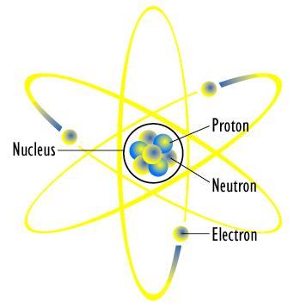
Rutherford’s model
Rutherford used his results to make a new model of the atom.
This model was mainly empty space. This accounted for the alpha particles that were not deflected.
Rutherford's model had a dense, positive core. This core had to be positive to account for the alpha particles that were deflected.
The core, which Rutherford called the nucleus, had to be extremely dense to account for the backscattered particles.

Slide 17
Flaws on Rutherford’s model
Rutherford's atomic model of negative electrons orbiting a positive, dense nucleus raised questions about how the electrons remained in orbit.
For example, Maxwell's Equations said that electrons orbiting the nucleus must rapidly lose energy. This would cause them to lose speed and fall into the nucleus in about a billionth of a second.
This obviously doesn't occur, so Rutherford's original model could not be correct. Luckily, Bohr would use quantum physics to refine it into a model which accounted for this.

Slide 18
Rutherford-bohr model
Niels Bohr proposed a new atomic model which improved on Rutherford's model.
We call this the Rutherford-Bohr Model.
Bohr proposed that electrons existed in energy states. This means that they can only have certain amounts of energy. When electrons are in their energy states, called their orbitals, they would not lose energy.

Slide 19
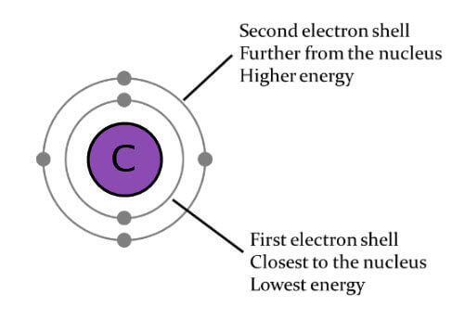
Electron Energy levels
They gain or lose certain amounts of energy to move between these energy levels, which we call orbitals.
Electrons in the lowest energy level have the least possible amount of energy. Electrons in higher energy levels have more energy.
A photon is emitted when an electron goes to an orbital with a lower energy level.

Slide 20
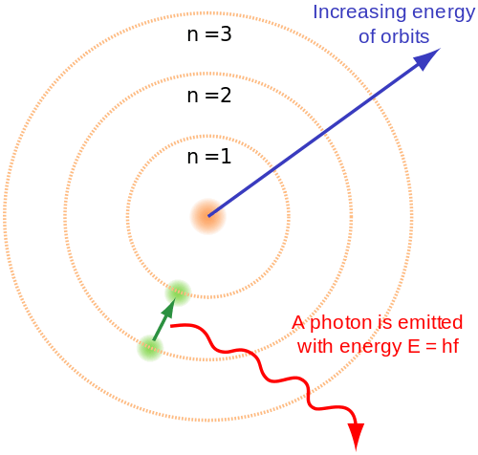
Summary of the Rutherford-bohr model
Electrons are in orbitals which correspond to energy states.
There is a dense, positive nucleus.
Most of the atom is empty space.

Slide 21
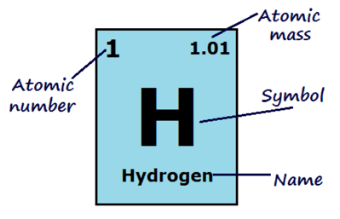
Atomic Numbers
The atomic number of an atom is how many protons the nucleus has.
This is what defines an element! If an atom has 1 proton it is hydrogen, if it has 8 protons it is oxygen and if it has 94 protons it is plutonium.

Slide 22

Neutral atoms
Atoms are neutral.
They have the same amount of electrons as protons, so the atomic number of an atom is also how many electrons it has.

Slide 23
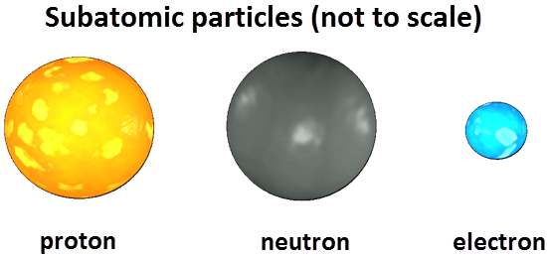
Mass number
The mass number is the mass of one atom of an element.
It is the number of protons plus the number of neutrons in the nucleus of the atom.
Electrons are not considered when calculating the mass number because their mass is so small compared to protons and neutrons.

Slide 24
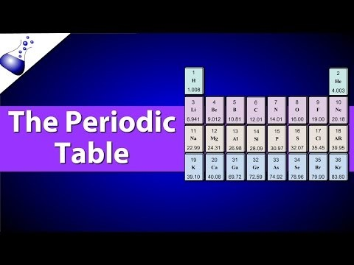

Slide 25
Calculating neutrons
To find the number of neutrons in an atom, subtract the atomic number from the mass number:
mass number - atomic number = number of neutrons​
For example, the mass number (number of protons + neutrons) of one form of hydrogen could be 2, and the atomic number (number of protons) is 1. Therefore the number of neutrons in this hydrogen atom is 2−1=1.

Slide 26
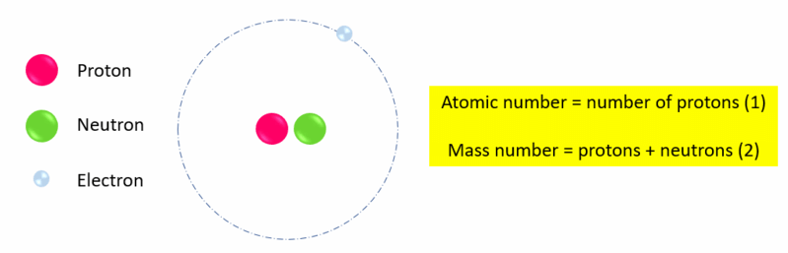

Slide 27
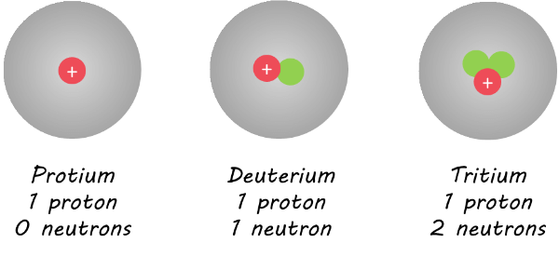
Nuclides
Nuclides are defined as the range of atomic nuclei associated with a particular atom, which is defined by the atomic number and the various isotopes of that atom as identified by the mass number.
For example hydrogen can have the following nuclides:

Slide 28
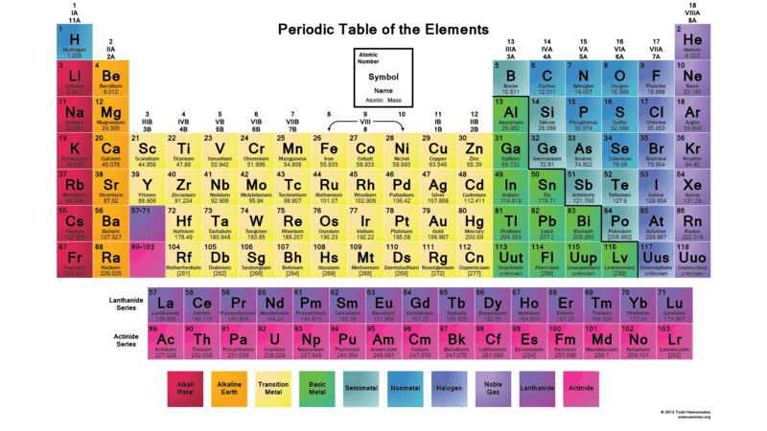
Organising nuclides
We organise atoms into groups based on the number of protons and neutrons, and energy level of electrons.
There are several different nuclide families that we can organise atoms into.

Slide 29
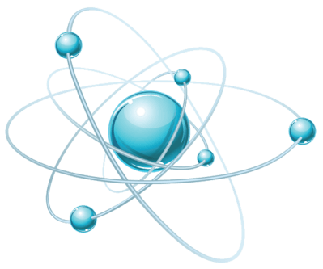
Nuclide Families
Isotopes all have the same number of protons, but vary in numbers of neutrons.
Isobars all have the same mass number. This does not necessarily mean that they have the same number of protons and neutrons.
Isotones have the same number of neutrons.
Nuclear isomers have the same number of protons and neutrons, but have different energy states.

Slide 30
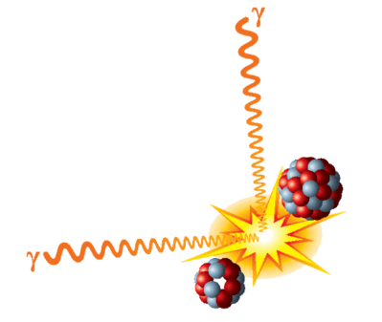
Unstable nuclei
A nucleus is held together by strong nuclear forces.
These hold the protons and neutrons together, even though there is electrostatic repulsion between the protons.
If there is an excess of protons, neutrons or mass in a nucleus, it may be unstable.
Unstable nuclei tend to emit radiation to become more stable.

Slide 31
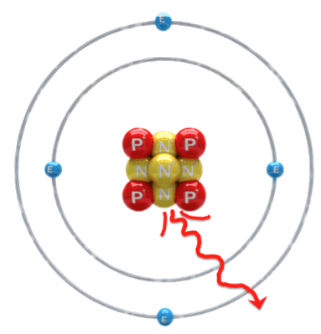
Radioactive decay
Radioactive atoms can emit alpha, beta, or gamma radiation.
The emission of alpha and beta radiation causes the parent atom to decay into a daughter atom.
Gamma radiation does not cause atoms to decay. However, it does lower the energy level of the atom. Gamma radiation has no mass or charge, only energy.

Slide 32
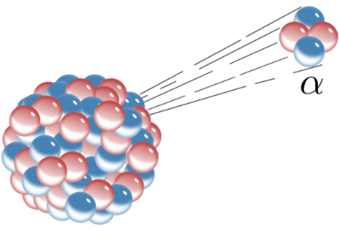
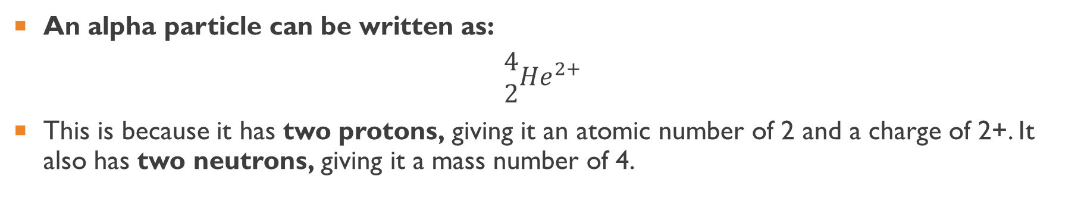
Alpha Decay
An alpha particle can be written as:
$$\begin{matrix}4 \\ 2\end{matrix}He^{2+}$$
This is because it has two protons, giving it an atomic number of 2 and a charge of 2+. It also has two neutrons, giving it a mass number of 4.
This means that when a parent nucleus emits an alpha particle its atomic number must decrease by 2 and its mass number must decrease by 4.

Slide 33

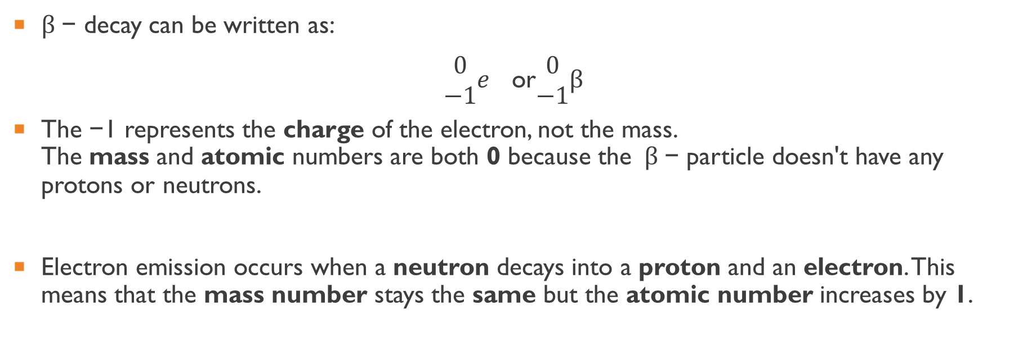
Beta - decay
$β$− decay can be written as:
$\begin{matrix}0 \\ −1\end{matrix}e$ or$\begin{matrix}0 \\ −1\end{matrix}β$
The −1 represents the charge of the electron, not the mass. The mass and atomic numbers are both 0 because the $β$− particle doesn't have any protons or neutrons.
Electron emission occurs when a neutron decays into a proton and an electron. This means that the mass number stays the same but the atomic number increases by 1.

Slide 34

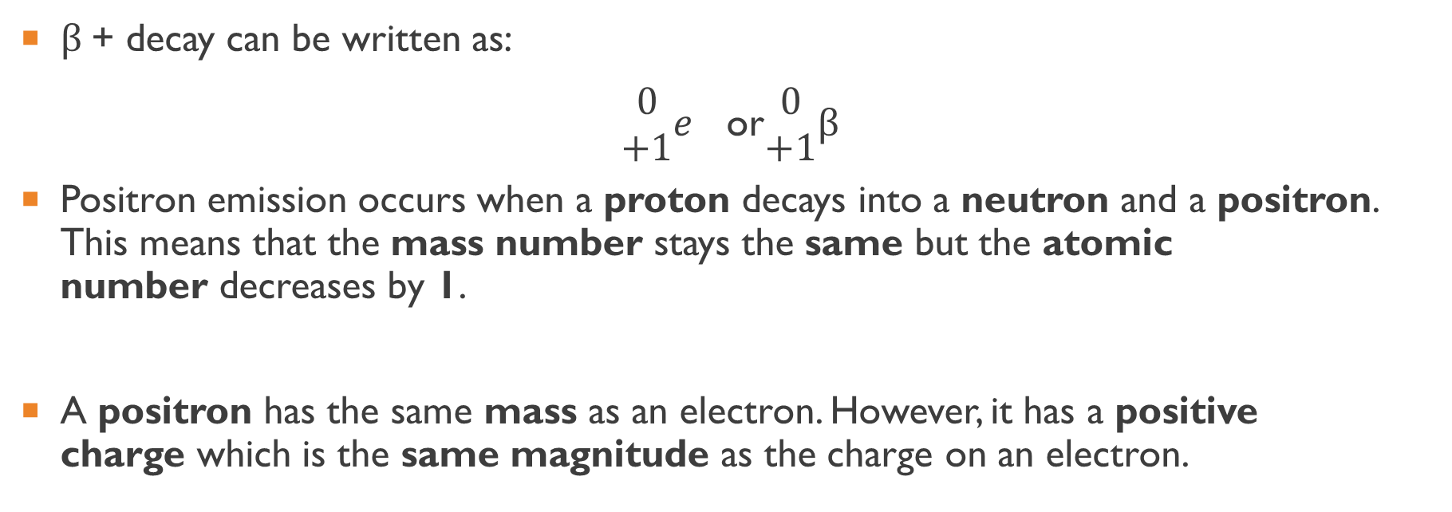
Beta + decay
$β$+ decay can be written as:
$\begin{matrix}0 \\ +1\end{matrix}e$ or$\begin{matrix}0 \\ +1\end{matrix}β$
Positron emission occurs when a proton decays into a neutron and a positron. This means that the mass number stays the same but the atomic number decreases by 1.
A positron has the same mass as an electron. However, it has a positive charge which is the same magnitude as the charge on an electron.

Slide 35
Natural radioactive decay
Atoms in nature are either stable or unstable. This is determined by the nuclear forces. If the forces are balanced, the atom is stable. If the forces are unbalanced, such as due to a different ratio of protons to neutrons, the nucleus will have an excess of energy. It will spontaneously give out particles or energy to become stable.
Natural radioactive decay is the process by which the nucleus of an unstable atom loses energy by emitting radiation, including alpha particles, beta particles, gamma rays and electrons without artificial stimulus to do so.

Slide 36
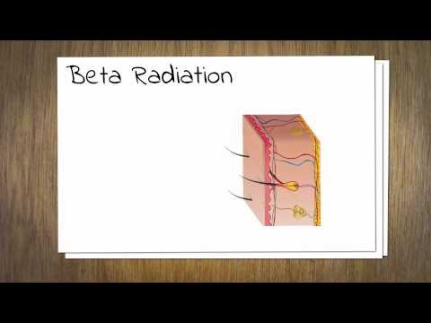

Slide 37
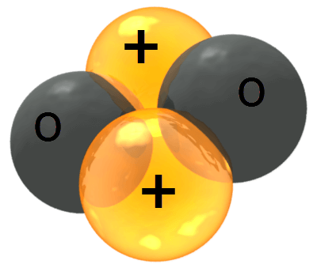
Alpha Particles
Alpha radiation is basically the emission of a helium nucleus.
This is because alpha particles are made up of two protons and two neutrons.
Alpha particles are large, positively charged and slow moving. They have the symbol α.
They have a range of a few centimetres in air and have a very low penetrating power. Alpha particles can not pass through paper or skin. Alpha particles are highly ionising because of their double positive charge, large mass and because they are relatively slow.

Slide 38
Beta radiation
There are two types of beta radiation:
electron emission (or β− decay) and positron emission (or β+ decay).
Both of these particles have a range of a few metres and moderate penetrating power. Beta particles can be blocked by a few millimetres of aluminium.
Electron emission is the emission of a negatively charged electron. This is modelled by a neutron changing into a proton and an electron.
Positron emission is the emission of a positively charged electron. This is modelled by a proton changing into a neutron and an electron.

Slide 39
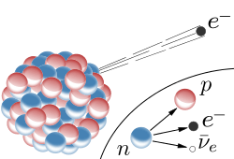
Beta particles are less ionising than alpha particles, having a single charge. They can travel a few metres through air or millimetres into living tissue, and exposure can cause burns to the skin. If beta emitting radionuclides are ingested or inhaled, they can damage internal organs.

Slide 40
Gamma radiation
Gamma radiation is a form of very high frequency electromagnetic radiation.
Gamma rays are highly penetrating. They can be blocked by 30cm of steel, but their intensity can be halved by 1cm of lead.
There is no maximum range of gamma rays in air. This is because they are so energetic that they are not absorbed by air.

Slide 41
Gamma rays are a form of electromagnetic radiation. They can be described as photons (massless particles) which travel as waves at the speed of light.
They are less ionising than alpha or beta radiation, but can penetrate much greater distances, requiring materials such as lead to stop them.

Slide 42
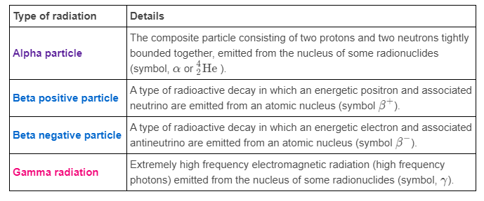
Summary of radiation types

Slide 43
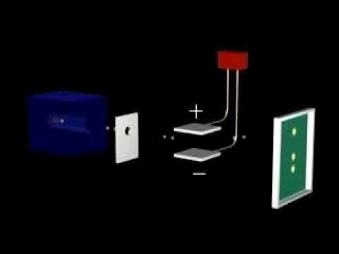
Effect of electric and magnetic fields on radiation

Slide 44
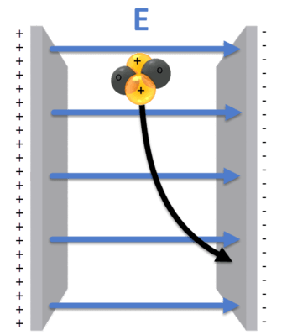
Alpha radiation
Alpha radiation is deflected in the same direction as the direction of the electric field.
Electric fields always go from the positive plate to the negative plate. Therefore, alpha particles move towards the negative plate in this system.

Slide 45
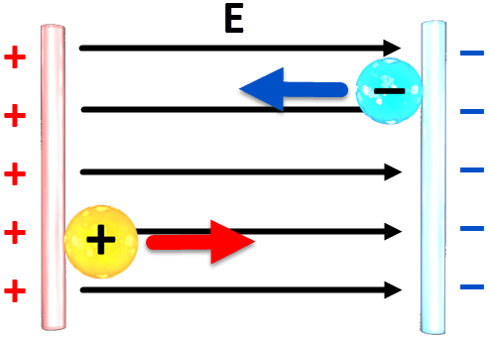
Beta radiation
β- decay emits negative electrons, so they are deflected in the opposite direction of an electric field. This means they move to the positive plate.
β+ decay emits positive positrons, so they are deflected in the same direction as the direction of the electric field. Therefore, they move to the negative plate.
The magnitude of the deflection of these two particles is the same, but it is in the opposite direction.

Slide 46
Gamma radiation
Gamma radiation has no charge, so it is not deflected when it passes through an electric field.

Slide 47

Writing Nuclear reactions
Nuclear reactions can be represented with a reaction equation, similar to how you would write a reaction equation for a chemical reaction.
Nuclear reaction equations must always show the mass and the charge of each particle involved in the reaction. For example, the reaction equation for the alpha decay of polonium-209 is:
his equation shows that polonium-209 decays into lead-205 plus an alpha particle.

Slide 48

Rules for writing nuclear reaction equations
There are two rules that you must follow when writing nuclear reaction equations:
1. The total mass numbers must be the same on each side of the equation.
2. The total nuclear charge must be the same on each side of the equation.

Slide 49
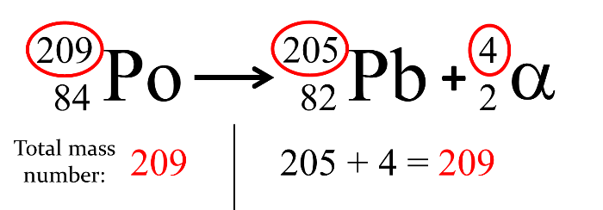
Nuclear equation example
1. The total mass numbers must be the same on each side of the equation.
In this alpha decay reaction, the starting element is polonium-209. This decays into lead-205 and an alpha particle:
Polonium's mass number is 209. The mass number of the lead is 205, while the mass number of the alpha particle is 4. Each side of the reaction equation has a total mass number of 209.

Slide 50
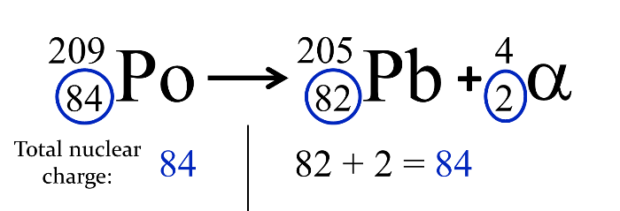
Nuclear equation example Pt2
2. The total nuclear charge must be the same on each side of the equation.
Polonium's nuclear charge is 84. The nuclear charge of the lead is 82, while the nuclear charge of the alpha particle is 2. Each side of the reaction equation has a total nuclear charge of 84.

Slide 51
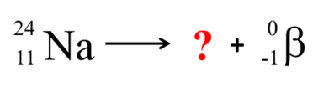
Completing Nuclear Equations
If you know the type of nuclear decay that a certain element undergoes, you can figure out which element is produced in the reaction!
Say you know that sodium-24 undergoes beta negative decay. You can write down the nuclear equation with information that you know:
This makes it easy to see what you need to find out about the element produced in the reaction.

Slide 52
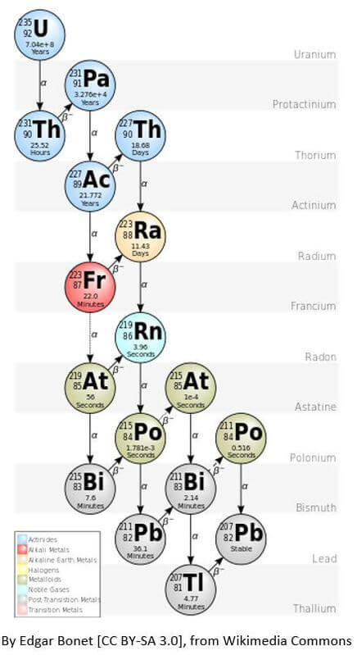
Decay Series
Often when a radionuclide decays, it forms another unstable atom.
This atom will then also decay, forming a new atom. This will continue until a stable nuclide is formed.
We call this chain of reactions a decay series or chain.
For example, Uranium eventually forms lead through a series of decays, shown here:
In summary, a radionuclide will, through a series of spontaneous decays, become a stable nuclide.

Slide 53
Half-Life & Nuclear medicine

Slide 54
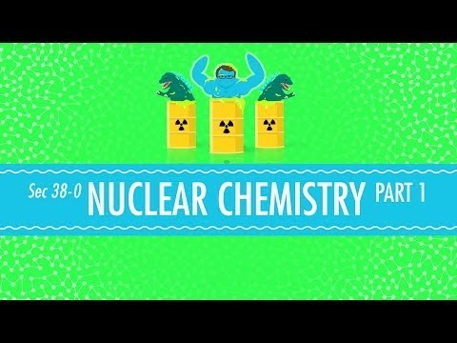
Half-life definition
The half-life is the time taken for half of the atoms in a sample of the material to undergo radioactive decay.

Slide 55
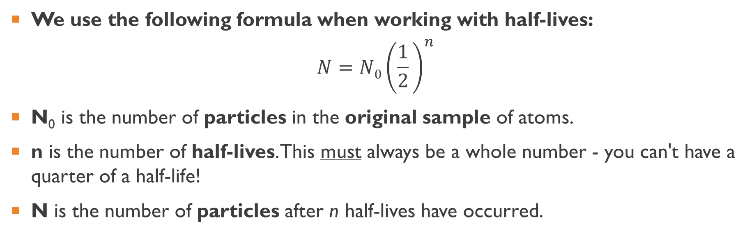
Half-Life formula
We use the following formula when working with half-lives:
$$N=N0​{\left(\frac{1}{2}​\right)}^{n}$$
N_{0​} is the number of particles in the original sample of atoms.
n is the number of half-lives. This must always be a whole number - you can't have a quarter of a half-life!
N is the number of particles after n half-lives have occurred.

Slide 56
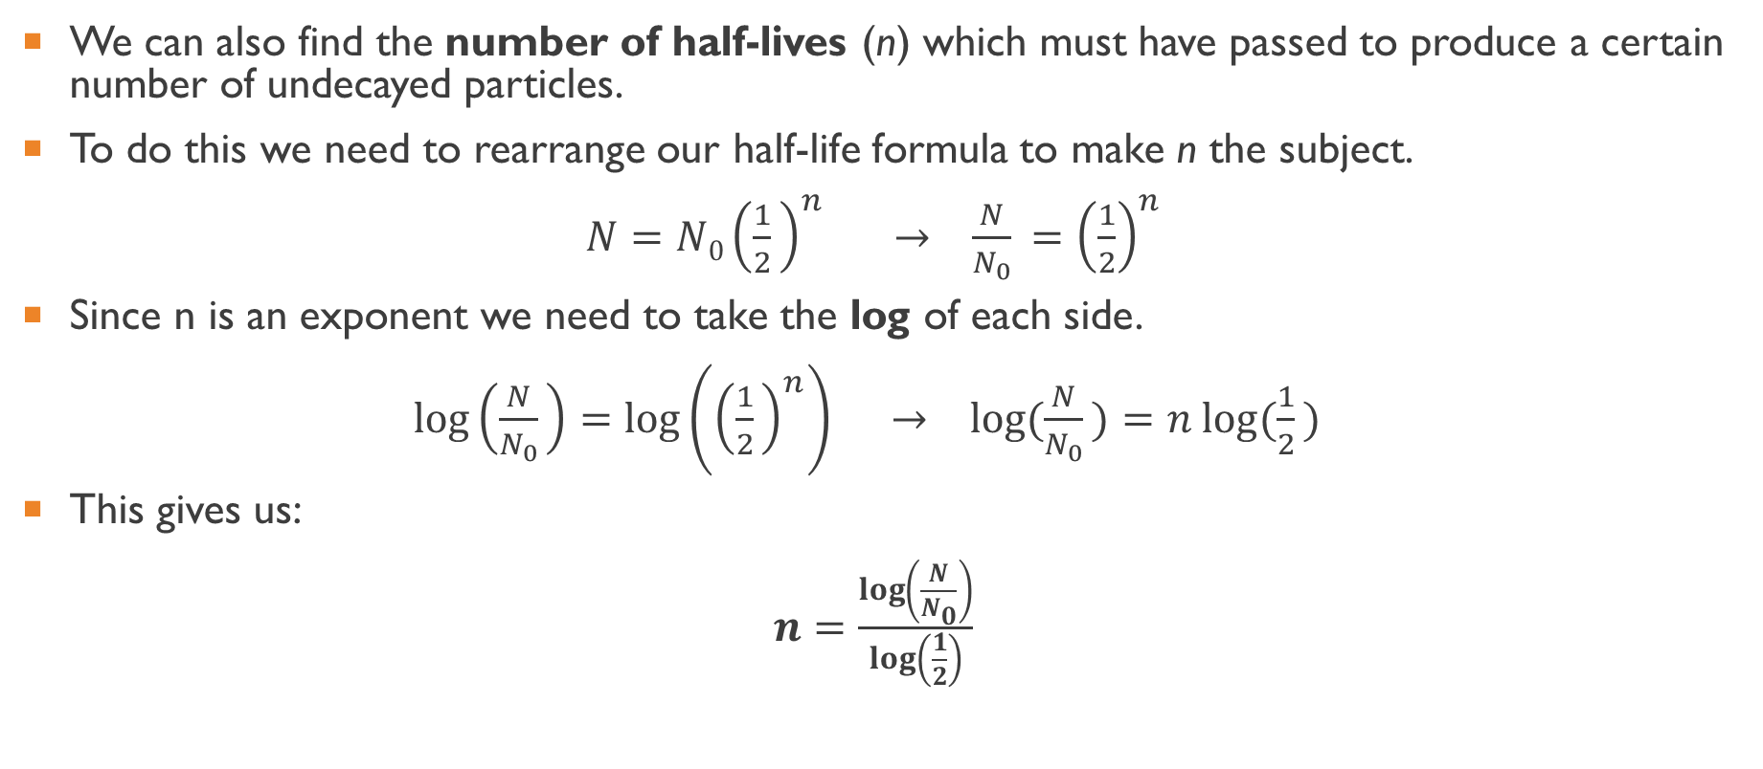
Calculating the number of half-lives
We can also find the number of half-lives (n) which must have passed to produce a certain number of undecayed particles.
To do this we need to rearrange our half-life formula to make n the subject.
$N=N0​{\left(\frac{1}{2}​\right)}^{n} →$ $\frac{N}{N_{0}}​={\left(\frac{1}{2​}\right)}^{n}$
Since n is an exponent we need to take the log of each side.
$\log\left(\frac{N}{N_{0}}​\right)=\log\left({\left(\frac{1}{2}​\right)}^{n}\right) → log⁡(\frac{N}{N_{0}}​)=n log⁡(\frac{1}{2}​)$
This gives us:
$n=\frac{\log\left(\frac{N}{N_{0}}\right)}{\log\left(\frac{1}{2}\right)​}$

Slide 57
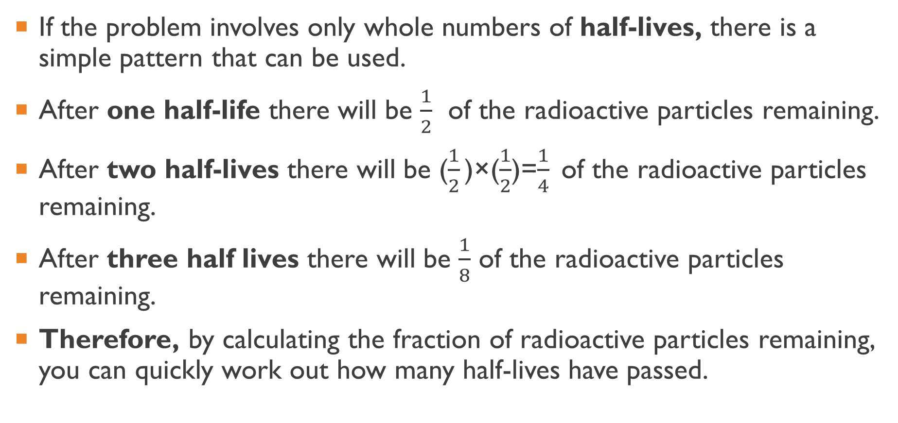
Calculating half-lives using fractions
If the problem involves only whole numbers of half-lives, there is a simple pattern that can be used.
After one half-life there will be $\frac{1}{2}$ of the radioactive particles remaining.
After two half-lives there will be ($\frac{1}{2}​$)×($\frac{1}{2}$​)=$\frac{1}{4}​$ of the radioactive particles remaining.
After three half lives there will be $\frac{1}{8}$ of the radioactive particles remaining.
Therefore, by calculating the fraction of radioactive particles remaining, you can quickly work out how many half-lives have passed.

Slide 58

Medical Uses
Radioactive elements are used in medicine to detect and treat medical problems.
Elements which emit gamma radiation (γ) are used to detect problems, while elements which emit beta radiation (β−) are used to treat them.

Slide 59


Slide 60
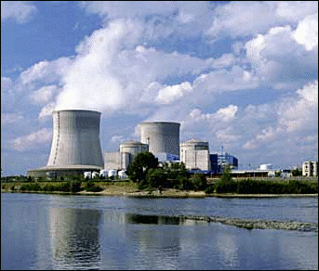
Isotope Production
Radioactive elements for medical use are made in Australia.
This is because radioactive elements often have short half lives. This means that they can't be imported from other countries, so we need to make our own.
The OPAL reactor in Sydney is used to make most of the elements Australia needs for medical purposes.

Slide 61
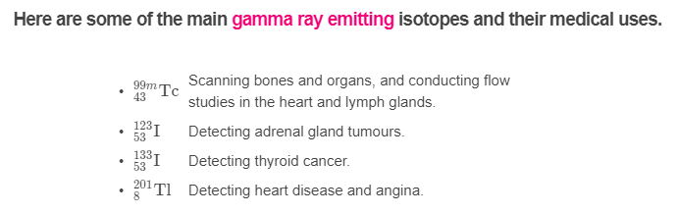

Gamma Ray Isotopes

Slide 62
Absorbed Dose
The severity of damage caused to human tissue will depend on the amount of radiation energy that is absorbed by the individual’s body.

Slide 63
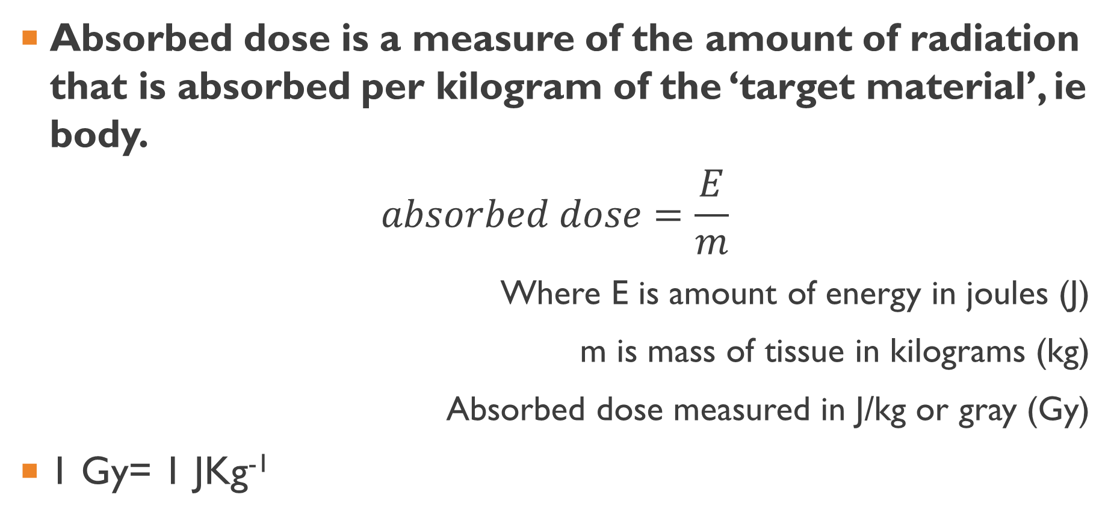
Absorbed Dose equation
Absorbed dose is a measure of the amount of radiation that is absorbed per kilogram of the ‘target material’, ie body.
$$absorbed dose=\frac{E}{m}$$
Where E is amount of energy in joules (J)
m is mass of tissue in kilograms (kg)
Absorbed dose measured in J/kg or gray (Gy)
1 Gy= 1 JKg⁻¹

Slide 64
Dose equivalent
Radiation | Quality factor
alpha | 20
neutrons | 10
beta | 1
gamma | 1
X-rays | 1
The ionising ability of different types of radiation affects how much damage it causes. Alpha radiation readily ionises, so an absorbed dose of alpha causes more damage than beta or gamma.
Each type of radiation is given a quality factor, or rating of how damaging an absorbed dose is to human tissue.

Slide 65
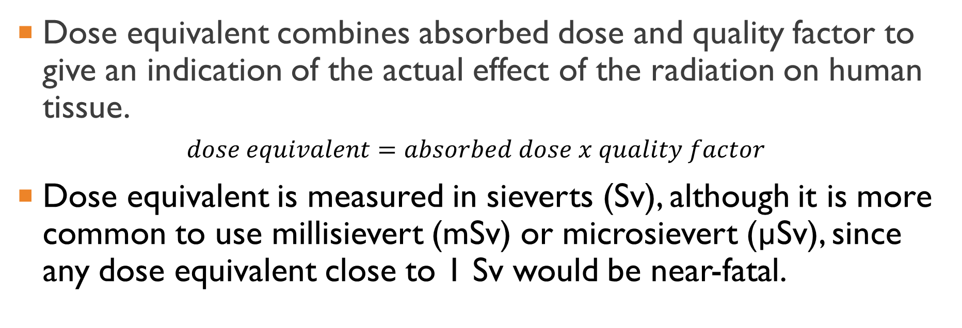
Dose equivalent combines absorbed dose and quality factor to give an indication of the actual effect of the radiation on human tissue.
$$dose equivalent=absorbed dose x quality factor$$
Dose equivalent is measured in sieverts (Sv), although it is more common to use millisievert (mSv) or microsievert (µSv), since any dose equivalent close to 1 Sv would be near-fatal.

Slide 66
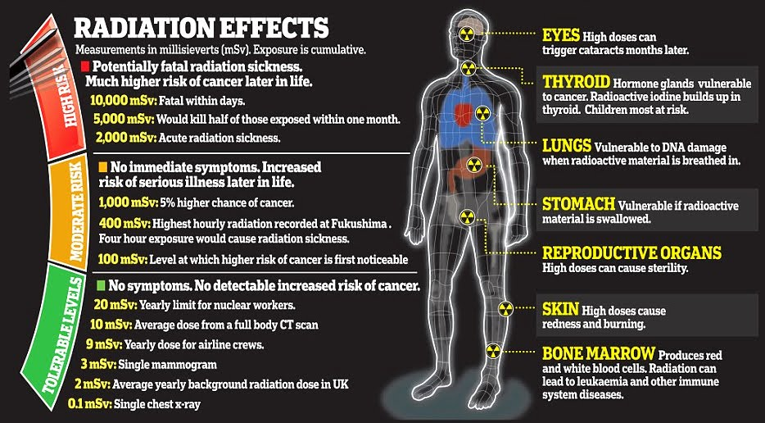

Slide 67
Nuclear stability, energy & Mass difference

Slide 68
Learning Intentions
Describe energy in terms of electron volts (eV) and Joules (J).
Recall Einstein's mass-energy equivalence relationship.
Solve problems involving Einstein's mass-energy equivalence relationship.

Slide 69
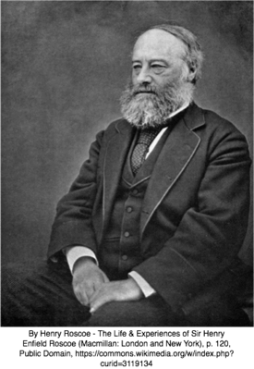
Electron Volt
When working on an atomic scale, the Joule is too large a unit to be helpful in calculations. Instead we often use the unit called an electron Volt (eV).
This is defined as a unit of energy equal to the work done on an electron in accelerating it through an electrical potential difference of 1 volt.

Slide 70
So how much energy is an electron Volt?
1eV≈1.602×10⁻¹⁹J
Atomic properties such as ionisation energies are usually quoted in eV.
As there are often large numbers of electron Volts, prefixes may be used:
1MeV is 1 mega electron Volt, or 1×10⁶eV.
1GeV is 1 giga electron Volt, or 1×10⁹eV.

Slide 71
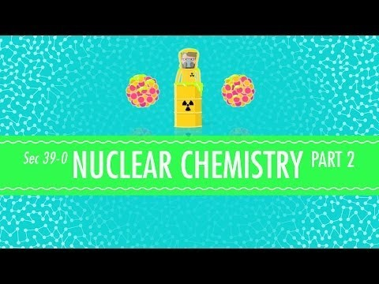
Conservation of mass and Energy

Slide 72
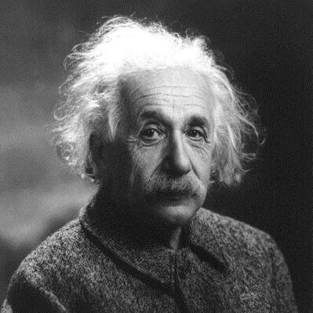
Mass Defect
The sum of the masses of the individual nucleons is more than the mass of the nucleus.
The answer lies in Einstein's famous equation: ΔE=Δmc². This equation states that mass is a form of energy, just like kinetic energy or heat energy. This explains why the missing mass, called the mass defect (Δm), was transformed into energy.

Slide 73
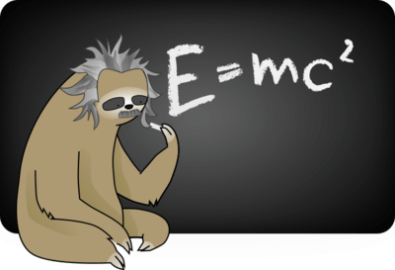
Einstein's mass-energy equivalence relationship
ΔE=Δmc²
In this famous equation, ΔE represents a change in energy.
Δm is change in mass.
c is the speed of light, which is a constant.
c≈3×10⁸ ms⁻¹

Slide 74
Nuclear Binding Energy
The mass defect is converted into energy.
This energy, called the nuclear binding energy, is the energy needed to break the nucleus into the nucleons that make it up.
The nuclear binding energy per nucleon can be used as a measure of stability. A stable nucleus has more binding energy per nucleon than an unstable nucleus.

Slide 75
Calculating Mass Defect
The mass defect is the difference between the mass of the nucleus and the mass of the nucleons which make it up.
We can write this as:
m_{nucleus}​=m_{nucleons}​+Δm
Rearranged, this gives:
Δm=m_{nucleus}​−m_{nucleons}​

Slide 76
Calculating Binding Energy
Binding energy is defined as the mechanical work that must be done against the forces holding a nucleus together to disassemble it into component parts
We find the binding energy of a nucleus with the E=Δmc² formula.
c is the speed of light.
c≈3.00×10⁸ ms⁻¹
The energy is always negative, because it is being released from the nucleus.

Slide 77
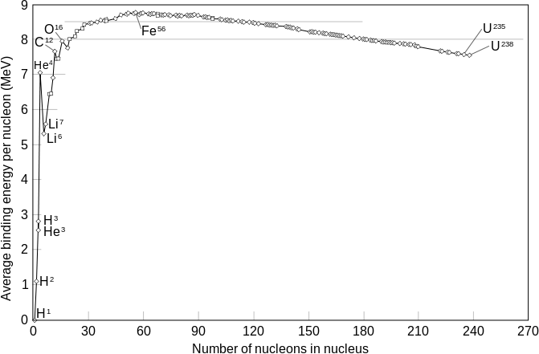
Is the binding energy the same for a nucleon in different atoms?
To answer this you need to calculate the binding energy of each nucleon.
The binding energy per nucleon is the binding energy divided by the number of nucleons in the nucleus of an atom.
If this is plotted against atomic mass, it shows that as you increase mass from hydrogen through the lighter elements, the binding energy per nucleon increases. This is due to higher forces between the increasing nucleons. In heavier elements there is less change in binding energy per nucleon, eventually decreasing slightly due to the impact of electromagnetic forces.

Slide 78
Fission & Fusion

Slide 79
Learning Intentions
Define nuclear fission.
Explain a neutron-induced nuclear fission reaction, including references to extra neutrons produced from many of these reactions.
Explain a fission chain reaction.
Define nuclear fusion.
Explain that more energy is released per nucleon in nuclear fusion then in nuclear fission because a greater percentage of the mass is transformed into energy.

Slide 80
Nuclear Fission
Nuclear fission is the process of splitting the atom.
It is defined as the process in which a large unstable nucleus splits, forming two (or more) smaller, more stable nuclei and releasing neutrons and energy.
A large, unstable atom absorbs a neutron, which causes it to split into two smaller nuclei. These two fission fragments are much more stable than the original nucleus.

Slide 81
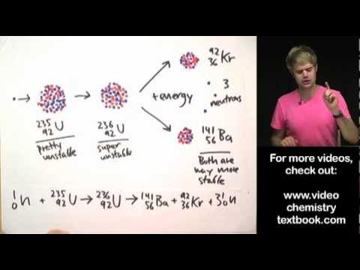

Slide 82
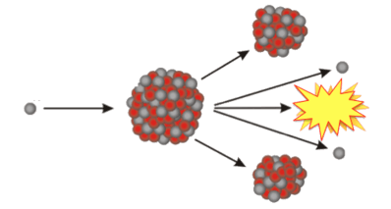
Uranium-235
Let's look at an example:
Uranium-235 absorbs a slow neutron to form uranium-236, which is extremely unstable. It immediately decays into two smaller fission fragments.
Two or three fast neutrons and energy are also produced in this reaction.

Slide 83

Chain Reactions
Chain reactions occur when the neutrons produced in one fission reaction strike another unstable nucleus, inducing another fission reaction.

Slide 84
Controlled or uncontrolled chain reactions
Controlled reactions are used in nuclear power plants because they sustain the original effect.
Uncontrolled reactions are used in nuclear bombs because they magnify the original effect.

Slide 85

Controlling Fission Chain reaction
As the neutrons are released from the fission of a nucleus, they must be absorbed and not allowed to split more atoms.
In this way, the rate of splitting the atoms and energy released is controlled.

Slide 86

Which atoms are used in fission reactions?
Any fissionable nuclide can under go nuclear fission after absorbing a neutron. We mentioned uranium-235 before, but there are some other fissionable nuclides, although they are uncommon.
Uranium-235 and plutonium-239 are both fissionable. A slow neutron (low energy) can induce nuclear fission with these atoms. Atoms that only require slow neutrons to split are described as fissile.
Uranium-238 is only slightly fissionable. It requires a fast neutron (high energy) to undergo nuclear fission.

Slide 87

Nuclear Fusion
Nuclear fusion is the process of two nuclei joining together to make one larger nucleus.
It is defined as a nuclear reaction in which two or more atomic nuclei combine to form one or more different, heavier atomic nuclei and subatomic particles.

Slide 88

Where does nuclear fusion occur?
Fusion reactions generally only occur in stars, although they could occur anywhere in the universe for a very short time after the Big Bang. This is because of the large energy input required to initiate fusion reactions.
Research is being carried out into how to control a fusion reaction to generate energy.
Uncontrolled nuclear fusion is used in thermonuclear weapons (hydrogen bombs).

Slide 89

Nuclear Fusion example
Unlike nuclear fission, which involves splitting large atoms, nuclear fusion involves fusing together small atoms such as hydrogen and helium.

Slide 90
Energy from nuclear fusion
The mass of the large nucleus is less than the combined masses of the two smaller nuclei. This is called the mass loss (Δm) and it is converted into energy.
We find the energy released by using the following formula:
ΔE=Δmc²

Slide 91
Energy released by fusion compared to fission
More energy is released per nucleon in nuclear fusion than in nuclear fission.
This is because a greater percentage of the mass is transformed into energy, as fusion works with much smaller atoms.

Slide 92

Nuclear Power Plants
Nuclear power plants use the energy generated by nuclear fission to generate electricity. This is done through controlled nuclear fission.

Slide 93

Fuel rods
These fuel rods are made out of radioactive material.
Naturally occurring uranium ore is only 0.65% uranium-235, so it must be refined to increase the chances that a neutron will strike a U−235 atom.
Fuel rods must be 1−4% U−235 for controlled chain reactions to occur. Uncontrolled chain reactions occur when the fuel rods are 97% U−235.

Slide 94

What happens in a nuclear power plant?
First, a slow neutron is fired at the fuel rod where it strikes a U−235 atom and causes nuclear fission. The neutrons released from this fission reaction are used to initiate more reactions.

Slide 95

Moderators
Fast neutrons are released in nuclear fission, so a moderator is used to remove some of their energy.
This slows them down enough to be able to initiate a fission reaction.
Moderators are atoms which have slightly larger mass than neutrons. Some common moderators are hydrogen ($\begin{matrix}1 \\ 1\end{matrix}$​H), deuterium ($\begin{matrix}2 \\ 1\end{matrix}$H) and tritium ($\begin{matrix}3 \\ 1\end{matrix}$​H).

Slide 96
Control rods
Fuel rods are held within a reactor vessel.
This vessel reflects neutrons back to the fuel rods, ensuring the chain reaction can continue.
Control rods are used to control the reaction. They contain neutron poisons, such as boron-10 and absorb neutrons when they are lowered between the fuel rods.
When the rate of reaction is too low the control rods are raised, allowing more neutrons to be absorbed by U−235 atoms.

Slide 97

Steam Turbines
The energy generated from nuclear fission is converted into electrical energy by a steam turbine.
Nuclear fission generates heat energy, which is used to evaporate water. The steam created from this is used to drive the steam turbines, which generate electricity.

Slide 98


Slide 99

Summary of How nuclear power plants work
Uranium is mined and made into rods. These are placed into the core of the nuclear power plant.
A reaction occurs within the uranium rods. This produces lots of heat.
The heat evaporates the water surrounding the core, producing steam.
The steam turns a turbine, which produces electricity!

